Slide 1
Language Translator
Troy Flagg

Slide 2
Introduction
The goal is to create a front end to input text and language definitions and a backend which connects two cloud platforms together to perform translations.
Showcase the connection of various cloud technologies
Showcase the use of container technology.

Slide 3
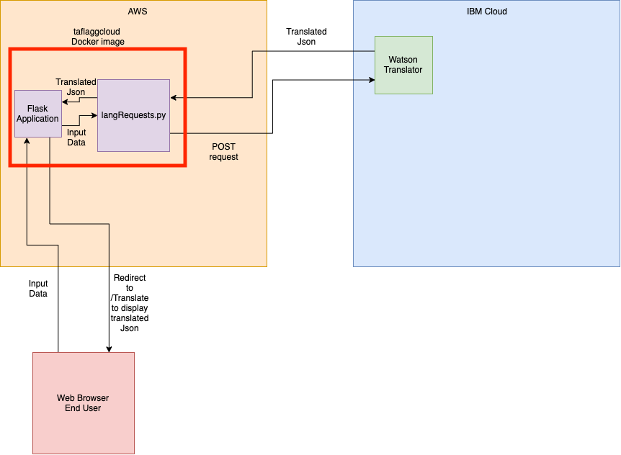
Architecture

Slide 4
Descriptions Behind The Two Clouds
IBM cloud was used as the target for my backend API. This specific API used was the Watson Translator API.
AWS was used to host a Docker image that contains the flask application as a front end and a backend to connect the flask app in AWS to the Translator API in IBM Cloud.
Please view how to use the application here https://github.com/tf3193/marist-mscs621-2019-TroyFlagg#running

Slide 5
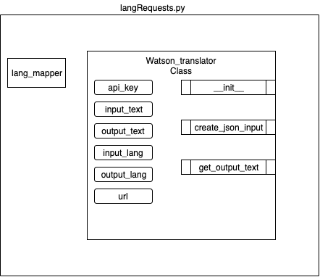
Backend
The backend is handled by a class made in python.
The class is created upon the request of the user to translate. All calls and jsonification are handled behind the scenes.
There is a mapper which maps all languages to their language code ex: English -> EN
You can view the code here https://github.com/tf3193/marist-mscs621-2019-TroyFlagg/blob/master/langRequests.py
Methods on right of class, fields on left

Slide 6
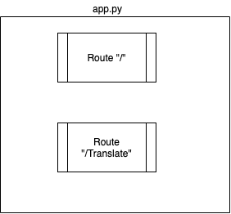
Frontend
A front end was created in flask with two endpoints
The base endpoint “/” is where the user first goes and is greeted with instructions on how to use the app. It also is where the user inputs all of their data.
The “/Translate” route is where the user is redirected after clicking the translate button. This will display the translated json if the model exited between the two languages, if not it will display an error.
You can view the code here https://github.com/tf3193/marist-mscs621-2019-TroyFlagg/blob/master/app.py

Slide 7
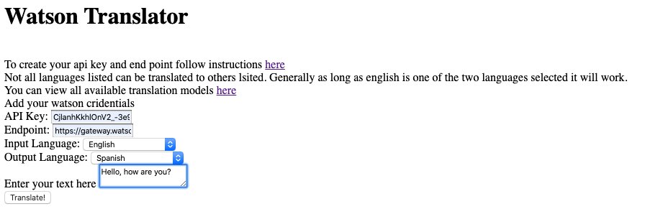
Demo

